Slide 1



Hospital ER: Data Analysis
Storytelling is a powerful tool for connecting with others.
by Joyson Prince Alvares

Slide 2

Agenda:
1
Data overview
2
Primary focus areas
The dataset provides insights into various aspects of patient experiences and demographics in a hospital emergency room (ER).
Patient Satisfaction:
Average satisfaction scores are tracked on a monthly basis.
The primary focus areas include patient satisfaction, wait times, demographic distributions, and department reference.
Helps identify trends and periods of high and low satisfaction.
Wait Times:
Average wait times for patients before receiving care, monitored monthly.
Highlights inefficiencies or improvements in the ER process.
3
Secondary focus areas
Demographics:
Gender and racial distribution of patients.
4
Purpose of analysis
Age distribution of patients, identifying age groups with highest and lowest patient counts.
To identify trends, inefficiencies, and areas for improvement in the ER.
Department References:
To enhance the quality of care and patient experience by providing actionable insights.
Distribution of patients across different hospital departments.

Slide 3

Patient demographics:
9216
Total Patients
This metric shows the # of patients who visited during the timeframe 2019-2020
51.05%
Male Count
Total Male visited = 4705 out of 9216
48.69%
Female Count
Total Female visited = 4487 out of 9216
0.26%
Non-Conforming Gender
Total NC gender visited = 24 out of 9216

Slide 4

Mean Monthly Patient satisfaction rate
1
Key Insights and Trends:
Seasonal Variation: The average satisfaction score shows noticeable variation across different months, indicating potential seasonal influences on patient satisfaction.
Identifying Peaks and Troughs: Specific months exhibit significantly higher or lower satisfaction scores, highlighting periods where patient experience was notably positive or negative.
2
Interpretation of the Data:
High Satisfaction Periods: Months with high satisfaction scores could coincide with lower patient volumes, improved staff performance, or successful implementation of new procedures.
Low Satisfaction Periods: Months with lower satisfaction scores may suggest higher patient loads, longer wait times, or other operational challenges that negatively impact patient experience.

Slide 5
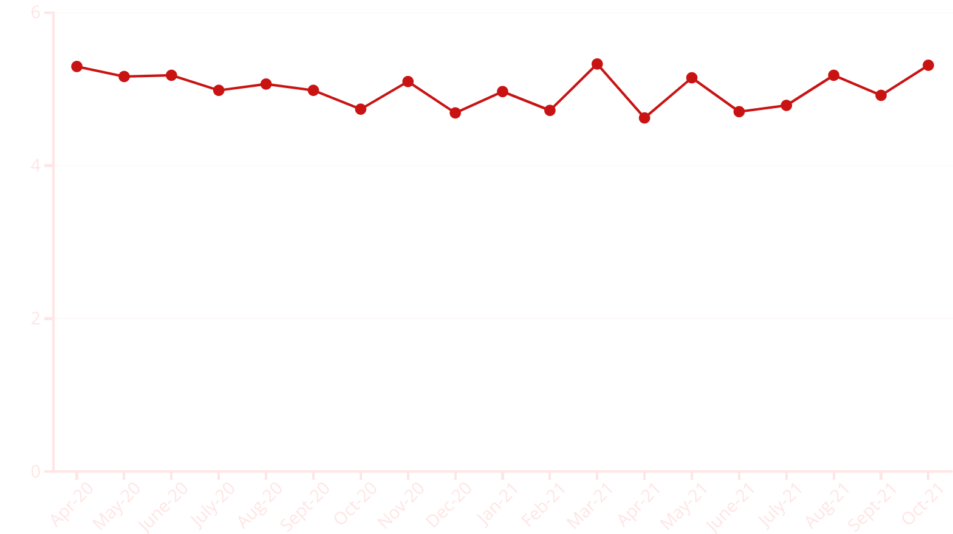

Slide 6

Mean Monthly Patient Wait-Time
1
Key Insights and Trends:
Trend Analysis: The average wait time varies month-to-month, reflecting the dynamic nature of ER operations and patient flow.
Critical Periods: Certain months have significantly longer wait times, indicating potential bottlenecks or inefficiencies in the ER process during those periods.
2
Interpretation of the Data:
Operational Efficiency: Months with shorter wait times may reflect periods of improved operational efficiency, effective staff management, or lower patient volumes.
Areas for Improvement: Longer wait times in specific months suggest areas where the ER can focus efforts to improve patient throughput and reduce waiting periods.

Slide 7
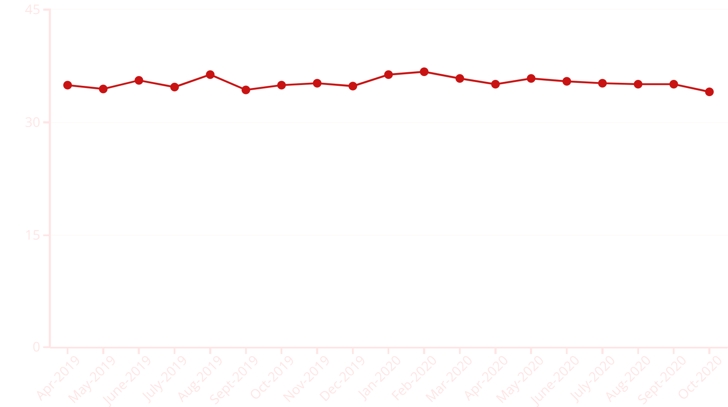

Slide 8

Patient Distribution by Age groups
1
Key Insights and Trends:
2
Interpretation of the Data:
Trend Analysis: The area chart shows the average wait times over time, highlighting periods of increased or decreased wait times.
Operational Efficiency: Decreased wait times in certain periods suggest improved operational efficiency and effective patient flow management.
Identifying Peaks: Specific periods with high wait times are easily identifiable, indicating potential inefficiencies or high patient volumes.
Areas for Improvement: Periods with high wait times indicate areas where the ER can focus efforts to reduce waiting periods and enhance patient experience.

Slide 9

Mean Hourly Patient Wait-Time
1
Key Insights and Trends:
Density of Visits: The heat map highlights areas with the highest concentration of patient visits, showing peak times and zones.
Utilization Trends: Identifies patterns of ER utilization, indicating when and where the ER is most and least busy.
2
Interpretation of the Data:
Resource Allocation: High-density periods may require increased staffing and resources to manage patient flow efficiently.
Operational Efficiency: Low-density areas indicate times when the ER is less utilized, presenting opportunities to optimize staffing and resources.

Slide 10

Patient Distribution by Race
1
Key Insights and Trends:
Racial Distribution: The bar chart displays the distribution of patients by race, highlighting the most and least represented racial groups in the ER.
Diversity Analysis: Shows the diversity of the patient population, indicating the racial demographics that the ER serves.
2
Interpretation of the Data:
Cultural Competence: Understanding the racial distribution helps in developing culturally competent healthcare services and ensuring inclusive patient care.
Resource Planning: High representation of certain racial groups may guide targeted community outreach and resource allocation to better serve those populations.

Slide 11

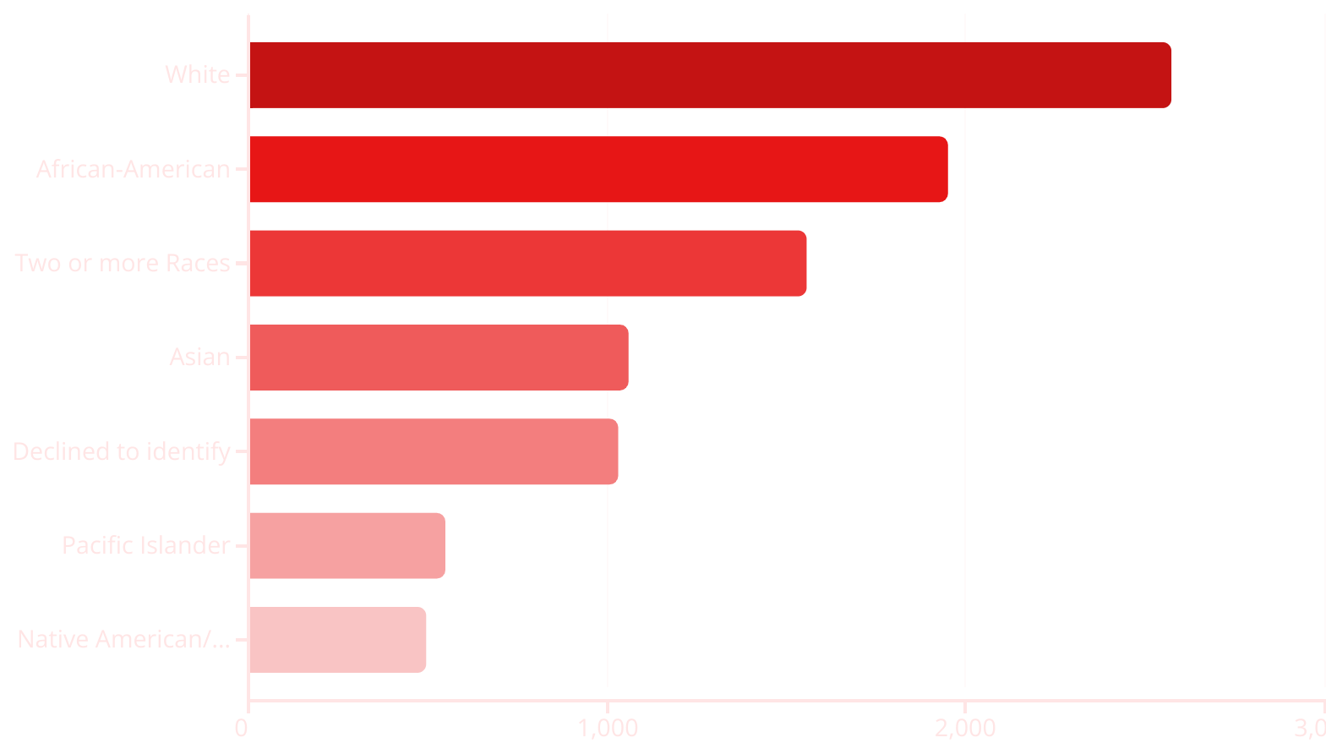

Slide 12

Patient Referrals by Medical Dept
1
Key Insights and Trends:
Departmental Distribution: The bar chart displays the distribution of patients across different hospital departments, showing which departments are most frequently referred to from the ER.
Utilization of Services: Identifies the departments with the highest patient referrals, indicating areas of high demand and resource utilization.
2
Interpretation of the Data:
Resource Allocation: Departments with high referral rates may need additional resources and staffing to handle the influx of patients.
Process Improvement: Lower referral rates in some departments may indicate areas for process improvement or better coordination with the ER.

Slide 13
